Slide 1
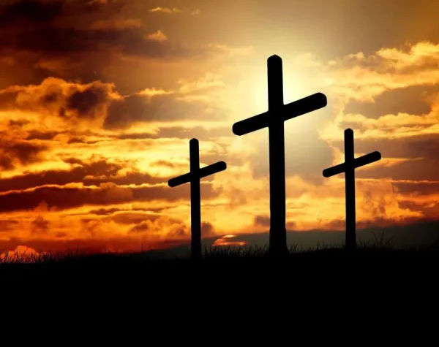
Hosanna (Praise Is Rising)

Slide 2
G C
Praise is rising, eyes are turning to You
G
We turn to You
G C
Hope is stirring, hearts are yearning for You
G
We long for You

Slide 3
D
'Cause when we see You
C G
We find strength to face the day
D
And in Your presence
C G
All our fears are washed away
D
washed away

Slide 4
G Em C
Hosanna, hosanna
G D
You are the God who saves us,
Em C
worthy of all our praises
X2 to verse 2

Slide 5
G C
Hear the sound of hearts returning to You
G
We turn to You
G C
In Your kingdom broken lives are made new
G
You make us new

Slide 6
D
'Cause when we see You
C G
We find strength to face the day
D
And in Your presence
C G
All our fears are washed away
D
washed away

Slide 7
G Em C
Hosanna, hosanna
G D
You are the God who saves us,
Em C
worthy of all our praises

Slide 8
G Em C
Hosanna, hosanna
G D
Come have Your way among us
Em C
We welcome You here Lord Jesus

Slide 9
D
'Cause when we see You
C G
We find strength to face the day
D
And in Your presence
C G
All our fears are washed away
D
washed away
x2 to chorus

Slide 10
G Em C
Hosanna, hosanna
G D
You are the God who saves us,
Em C
worthy of all our praises

Slide 11
G Em C
Hosanna, hosanna
G D
Come have Your way among us
Em C
We welcome You here Lord Jesus
play x2

Slide 12
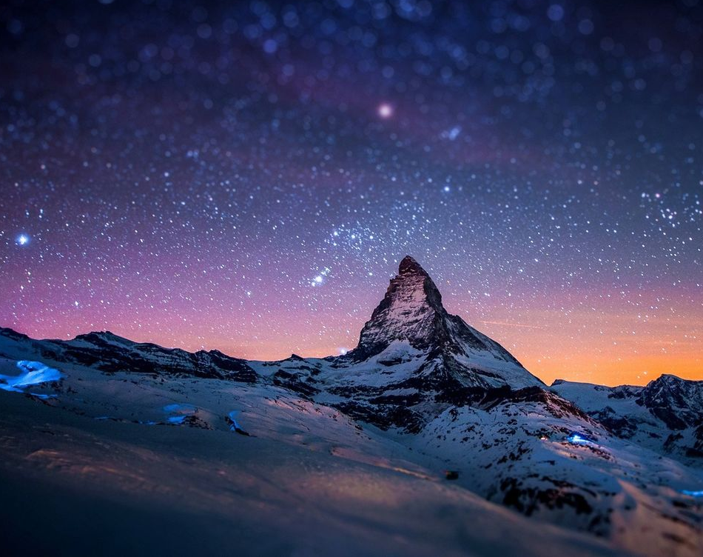
All sufficient merit

Slide 13
CAPO @ 4th
Am G F C F G
All sufficient merit Shining like the sun
Am G F C F G F C
A fortune I inherit By no work I have done
G Am F C
My righteousness I forfeit At my saviors cross
G Am F G C F
Where all sufficient merit Did what I could not

Slide 14
Am G F C F G
In love he condescended Eternal now in time
Am G F C F G C
A life without a blemish The maker made to die
G Am F C
The Law could never save us Our lawlessness had won
G Am F G C
Until the pure and spotless Lamb had finally come

Slide 15
G Am Em
It is done It is finished
F C
No more debt I owe
G
Paid in full
Am Em F G
All sufficient merit now my own

Slide 16
Am G F C F G
I lay down my garments Any empty boast
Am G F C F G C
Good works now all corrupted By the sinful host
G Am
Dressed in my LORD Jesus
F C
A crimson robe made white
G Am F G C
No more fear of judgement His righteousness is mine

Slide 17
G Am Em
It is done It is finished
F C
No more debt I owe
G
Paid in full
Am Em F G
All sufficient merit now my own

Slide 18
Am G F C F G
All sufficient merit Firm in life and death
Am G F C F G C
The joy of my salvation Shall be my final breath
G Am F C
When I stand accepted Before the throne of God
G Am F G C
I’ll gaze upon my Jesus And thank Him for the cross
F G C
Yes I’ll thank Him for the cross

Slide 19
G Am Em
It is done It is finished
F C
No more debt I owe
G
Paid in full
Am Em F G
All sufficient merit now my own
END

Slide 20
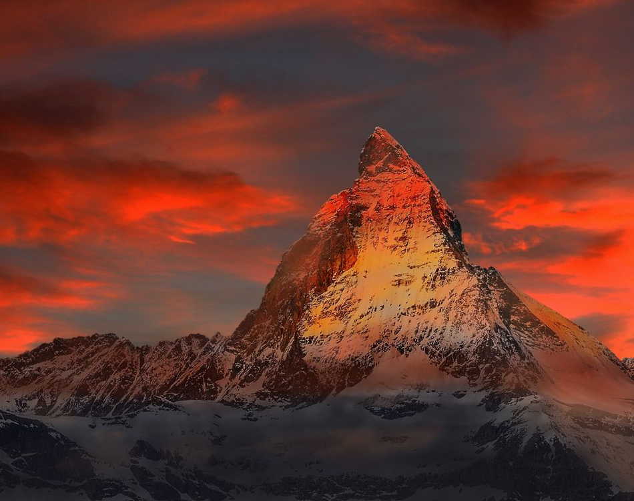
Hymn of Heaven

Slide 21
C Csus C
How I long to breathe the air of Heaven
Am F G
Where pain is gone and mercy fills the streets
C F C G Am
To look upon the one who bled to save me
F G C Csus C
And walk with Him for all eternity

Slide 22
C F G C
Oh, There will be a day When all will bow before Him
C F Am G
There will be a day When death will be no more
C F G C G Am
Standing face to face With He who died and rose again
F G C
Holy holy is the Lord

Slide 23
C F C
Every prayer we prayed in desperation
Am F G
The songs of faith we sang through doubt and fear
C F C G Am
In the end we’ll see that it was worth it
F G C Csus C
When He returns to wipe away our tears

Slide 24
C F G C
Oh, There will be a day When all will bow before Him
C F Am G
There will be a day When death will be no more
C F G C G Am
Standing face to face With He who died and rose again
F G C
Holy holy is the Lord

Slide 25
C F C
On that day we join the resurrection
Am F G
And stand beside the heroes of the faith
C F C G Am
With one voice a thousand generations
F G C
Sing “worthy is the Lamb who was slain”

Slide 26
C F C
On that day we join the resurrection
Am F G
And stand beside the heroes of the faith
C F C G Am
With one voice a thousand generations
F G C
Sing “worthy is the Lamb who was slain”
F G C Csus C
“Forever He shall reign”

Slide 27
C F G C
So let it be today we shout the hymn of Heaven
C F Am G
With angels and the Saints we raise a mighty roar
C F G C G Am
“Glory to our God” who gave us life beyond the grave
F G C
Holy holy is the Lord

Slide 28
C F G C
So let it be today we shout the hymn of Heaven
C F Am G
With angels and the Saints we raise a mighty roar
C F G C G Am
“Glory to our God” who gave us life beyond the grave
F G Am
Holy holy is the Lord
F G Am
Holy holy is the Lord
F G C Csus C
Holy holy is the Lord

Slide 29
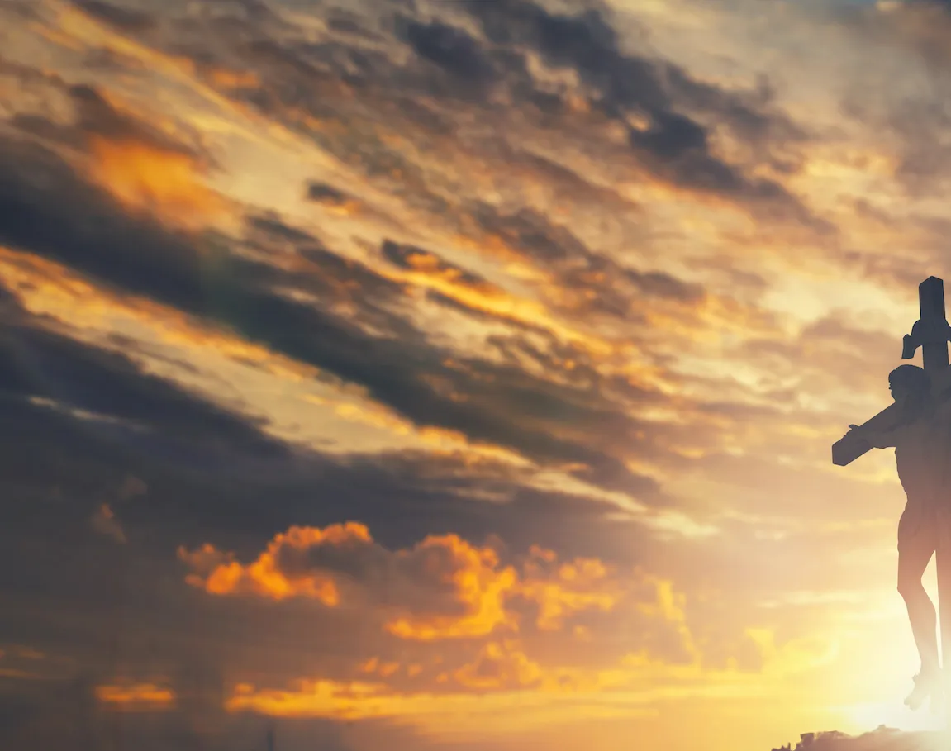
Your Grace is Enough

Slide 30
G C
Great is Your faithfulness oh God
Em D C
You wrestle with the sinner's heart
G C
You lead us by still waters and to mercy
Em D C
And nothing can keep us apart

Slide 31
Am G
So remember Your people
C D
Remember Your children
Am G C
Remember Your promise Oh God
to chorus

Slide 32
G D
Your grace is enough
Em C
Your grace is enough
G D C
Your grace is enough for me
to verse 2

Slide 33
G C
Great is Your love and justice God
Em D C
You use the weak to lead the strong
G C
You lead us in the song of Your salvation
Em D C
And all Your people sing along

Slide 34
Am G
So remember Your people
C D
Remember Your children
Am G C
Remember Your promise Oh God
to chrous

Slide 35
G D
Your grace is enough
Em C
Your grace is enough
G D C
Your grace is enough for me
x2 to pre chorus

Slide 36
Am G
So remember Your people
C D
Remember Your children
Am G C
Remember Your promise Oh God
to chorus

Slide 37
G D
Your grace is enough
Em C
Your grace is enough
G D C
Your grace is enough for me

Slide 38
G D
Your grace is enough
Em C
Heaven reaching down to us
G D C
Your grace is enough for me God I see
G D Em C
Your grace is enough I am covered in Your love
G D C
Your grace is enough for me…For me
END

Slide 39
Your Grace is Enough

Slide 40
G C
Great is Your faithfulness oh God
Em D C
You wrestle with the sinner's heart
G C
You lead us by still waters and to mercy
Em D C
And nothing can keep us apart

Slide 41
Am G
So remember Your people
C D
Remember Your children
Am G C
Remember Your promise Oh God
to chorus

Slide 42
G D
Your grace is enough
Em C
Your grace is enough
G D C
Your grace is enough for me
to verse 2

Slide 43
G C
Great is Your love and justice God
Em D C
You use the weak to lead the strong
G C
You lead us in the song of Your salvation
Em D C
And all Your people sing along

Slide 44
Am G
So remember Your people
C D
Remember Your children
Am G C
Remember Your promise Oh God
to chrous

Slide 45
G D
Your grace is enough
Em C
Your grace is enough
G D C
Your grace is enough for me
x2 to pre chorus

Slide 46
Am G
So remember Your people
C D
Remember Your children
Am G C
Remember Your promise Oh God
to chorus

Slide 47
G D
Your grace is enough
Em C
Your grace is enough
G D C
Your grace is enough for me

Slide 48
G D
Your grace is enough
Em C
Heaven reaching down to us
G D C
Your grace is enough for me God I see
G D Em C
Your grace is enough I am covered in Your love
G D C
Your grace is enough for me…For me
END

Slide 49
INVITATION

Slide 50
Turn Your Eyes Upon Jesus

Slide 51
G / Bm / C / D
G Bm
O soul are you weary and troubled
C G
No light in the darkness you see
G Bm
There's light for a look at the Savior
C D G
And life more abundant and free

Slide 52
G D Em D
Turn your eyes upon Jesus
C Em D
Look full in His wonderful face
G Bm
And the things of earth
Em G
Will grow strangely dim
G D G
In the light of His glory and grace

Slide 53
G Bm
Through death into life everlasting
C G
He passed and we follow Him there
G Bm
O’er us sin no more hath dominion
C G
For more than conquerors we are

Slide 54
G D Em D
Turn your eyes upon Jesus
C Em D
Look full in His wonderful face
G Bm
And the things of earth
Em G
Will grow strangely dim
G D G
In the light of His glory and grace

Slide 55
G D
Your grace is enough
Em C
Heaven reaching down to us
G D C
Your grace is enough for me God I see
G D Em C
Your grace is enough I am covered in Your love
G D C
Your grace is enough for me…For me
END

